Slide 1
MTN-025 Data Communiqué #1
CRF Updates

Slide 2
HOPE Migration – September 13, 2016
The MTN-025 database was updated to incorporate a number of CRF updates, as outlined in Data Communique #1 (19 SEP 2016)
Completion of eCRFs within Medidata Rave from this date forward incorporates these changes
Applicable paper CRFs have been versioned to 2.0 within visit packets and are available on Atlas with these changes

Slide 3
HOPE Migration – CRF Updates
1. Baseline Behavior Assessment and
Behavior Assessment
Items 11c1 on BBA and 8c1 on the BA updated from “If yes, please specify” to “Specify”
Instruction corrected to specific items referenced
Notes:
Minor wording updates have been made to items 11c1 on the Baseline Behavior Assessment and item 8c1 on the Behavior Assessment from “If yes, please specify” to only “Specify” to be consistent with translations. In addition, an instruction within the form has been updated to correct the specific items referenced (“Complete items 21-26 at PUEV or Early Termination visit only).

Slide 4
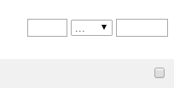
HOPE Migration – CRF Updates
2. Clinical Product Hold/Discontinuation Log
“Date of last study product use” item on the Clinical Product Hold/Discontinuation Log CRF has been updated to include an additional response,” Participant never used ring”.
Notes:
The “Date of last study product use” item on the Clinical Product Hold/Discontinuation Log CRF has been updated to include an additional response,” Participant never used the ring”. If a participant has never used the vaginal ring during HOPE and is placed on clinical product hold or permanently discontinued by a study clinician, leave the date field for this item blank and check the “Participant never used ring” box.

Slide 5
HOPE Migration – CRF Updates
3. HIV Test Results
The Rapid HIV Test kit type item on the HIV Test Results CRF has been updated to include a ‘Not applicable” response option.
Notes:
The Rapid HIV Test kit type item on the HIV Test Results CRF has been updated to include a ‘Not applicable” response option. If a 4th generation test is not available and a 3rd generation test was used, select the “Not applicable” response for the applicable rapid HIV test kit type and contact the MTN Laboratory Center for further guidance.

Slide 6
HOPE Migration – CRF Updates
4. Laboratory Results
Additional item to specify the associated AE term and onset date for an abnormal value that meets AE reporting criteria
Update has been made to paper CRF and update will be made to clinical database soon
Notes:
The Laboratory Results CRF has been updated to include an additional item to specify the associated AE term and onset date for an abnormal value that meets AE reporting criteria. This “specify AE” item has been added to the Hemoglobin, Platelets, WBC, Neutrophils, Lymphocytes, AST (SGOT) and ALT (SGPT) items for completion during follow-up, as indicated.

Slide 7
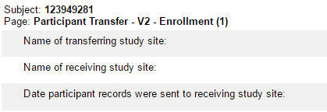
HOPE Migration – CRF Updates
5. Participant Transfer
“Last completed visit with participant” item removed
Notes:
The item “Last completed visit with participant” has been removed from the Participant Transfer CRF as this administrative question is no longer required within Medidata Rave. The Participant Transfer CRF should be added to the last completed study visit at the transferring site within the Rave database by selecting this form within the Additional Study Procedures CRF (or the Interim Visit Procedures form if the last completed study visit is an interim visit).

Slide 8
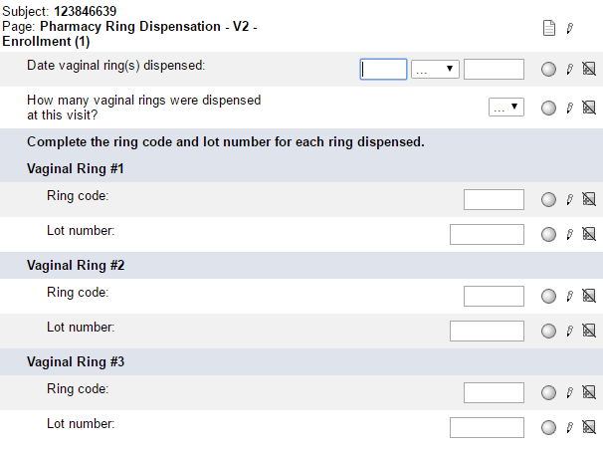
HOPE Migration – CRF Updates
6. Pharmacy Ring Dispensation
Item “Time vaginal ring(s) dispensed’ removed
Vaginal Ring #4 items removed
Notes:
The Pharmacy Ring Dispensation CRF has been updated to remove the “Time vaginal ring(s) dispensed” item as it has been determined that the time at which each ring has been dispensed is not needed within the clinical database. In addition, the updated CRF allows for up to three vaginal rings to be dispensed at a study visit (i.e., the “Vaginal Ring #4” items have been removed from this CRF). Please refer to SSP section 9.1 for further guidance on ring dispensation.

Slide 9
HOPE Migration – CRF Updates
7. Pelvic Exam
Two optional fields added to “Were any new pelvic finding AEs reported at this visit?”
Notes:
Two optional text fields have been added to the item “Were any new pelvic finding AEs reported at this visit?” in the event that more than one associated AE has been reported. Note that if a new pelvic finding AE is reported at a study visit (i.e., if this item is marked “Yes”), at least one AE term and onset date must be specified. For example, if a pelvic finding of cervical erythema is reported at a study visit and documented on the Pelvic Exam CRF, specify the associated AE within the first line provided and leave the two additional fields blank.

Slide 10
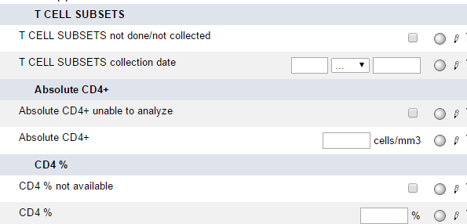
HOPE Migration – CRF Updates
8. Seroconverter Laboratory Results
Erroneous item within T CELL subsets item removed
Notes:
An erroneous item within the T CELL subsets item with response options ‘positive’ and ‘negative’ has been removed from the Seroconverter Laboratory Results CRF.

Slide 11
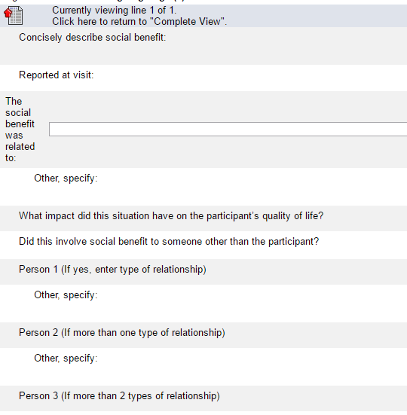
HOPE Migration – CRF Updates
9. Social Benefit Log
Item “How many people did this benefit involve?” has been removed from the form.
Notes:
The item “How many people did this benefit involve?” has been removed from the log form as this administrative question is no longer needed. If the reported social benefit involves someone other than the participant, select the type of relationship the social benefit involved for up to three persons (Person 1, Person 2, and/or Person 3).

Slide 12
HOPE Migration – CRF Updates
10. Specimen Storage
Item requesting reason when plasma is ‘not stored/not required’ has been updated to be required when plasma is ‘not stored’ at expected visits.
Notes:
The item requesting a reason when plasma is not ‘stored/not required’ at a study visit has been updated to be required only when plasma is ‘not stored’ at expected visits. If plasma storage is not required at a given visit, per protocol, a reason plasma is not required does not need to be specified and this item can be left blank.

Slide 13
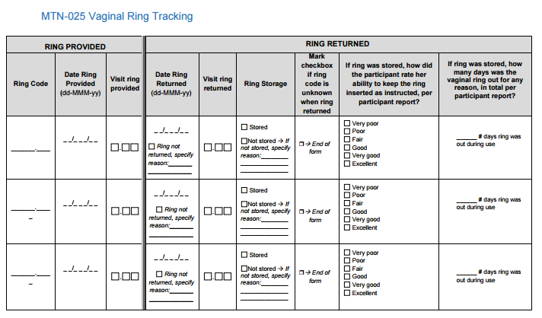
HOPE Migration – CRF Updates
11. Vaginal Ring Tracking Log
Additional rows have been added to the paper Vaginal Ring Tracking Log CRF to provide space in documenting provision and return of rings
Notes:
Additional rows have been added to the paper Vaginal Ring Tracking Log CRF to provide additional space in documenting the provision and receipt of vaginal rings throughout the study prior to data entry into the Rave database.

Slide 14
HOPE Migration II – Fall, 2016
A second migration is planned for this fall to update the database by:
New eCRF to provide sites with residual drug data per participant
Additional dynamic drop-down item to specify the associated AE term and onset date for an abnormal value that meets AE reporting criteria

Slide 15
Questions
Please contact SCHARP CDMs Melissa Peda (mapeda@scharp.org) and Jen Berthiaume (jberthia@scharp.org) for any questions about this slide presentation or Data Communiqué #1

